Slide 1
Introduction to eSight 21.0 Network Resource Management
Security Level:

Slide 2
This course describes how to use eSight to perform routine management, monitoring, and maintenance for network devices.

Slide 3
Upon completion of this course, you will be able to:
Have a good command of the management of network monitoring devices.
Have a good command of routine network management, monitoring, and maintenance methods.

Slide 4
1
Overview
2
Site Deployment
3
Routine O&M

Slide 5













Typical Networking of Network Services
Campus network
Central equipment room
OSS
Third parties
Network O&M personnel
NBI
Browser (Firefox, and Chrome)
Basic management
Convergence layer
Configuration file management
Topology
management
Alarm
management
Performance
management
Resource
management
Access layer
eSight
eSight
SNMP
Personal devices
Telnet/STelnet
SFTP
Router, switch, WLAN, and firewall
R&D network
Administrative region

Slide 6






eSight 20.1 Network Resource Management O&M Feature Overview
Batch delivery
Performance, alarm, and report
Command configuration
Basic monitoring
Network O&M
Resource management
Terminal management
Device, subrack, and board
Configuration file
Discovering suspicious and unauthorized terminals
Backup and restoration

Slide 7
1
Overview
2
Site Deployment
3
Routine O&M

Slide 8
Deployment Overview
Subnet planning
Device addition
Monitoring configuration
(Optional) You can customize the configurations based on network conditions.
Add the networks to be managed to eSight based on the SNMP and adjust their positions in the topology as required.
Subnet planning
Device addition
Monitoring configuration
Categorize network devices by subnet to facilitate hierarchical monitoring.
By default, performance collection tasks, large screens, and report data are preset and usable-upon-unpacking. You can adjust them as required.

Slide 9
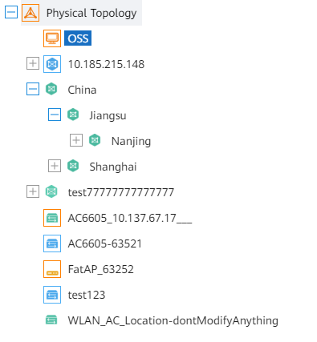
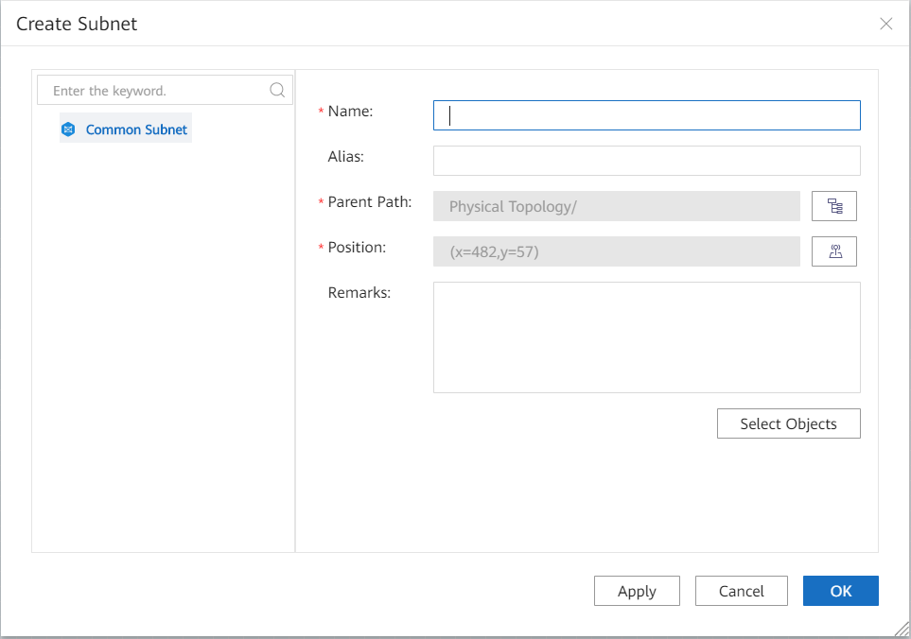
Subnet Planning
A large network is divided into several subnets based on a specific rule (by region or device type), which facilitates network management.
Generally, subnets are planned by region.
A device can belong to only one subnet.
The current subnet management is performed based on topology.
You can create, delete, or move a subnet only by right-clicking the blank area in the topology view.

Slide 10
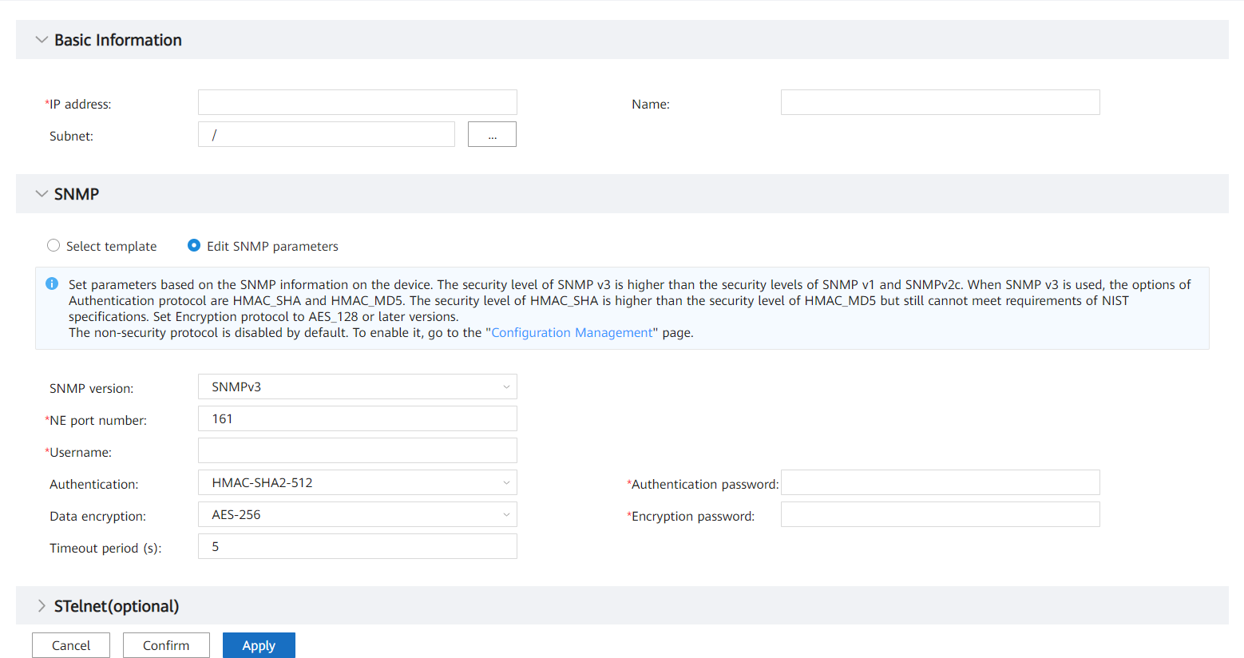
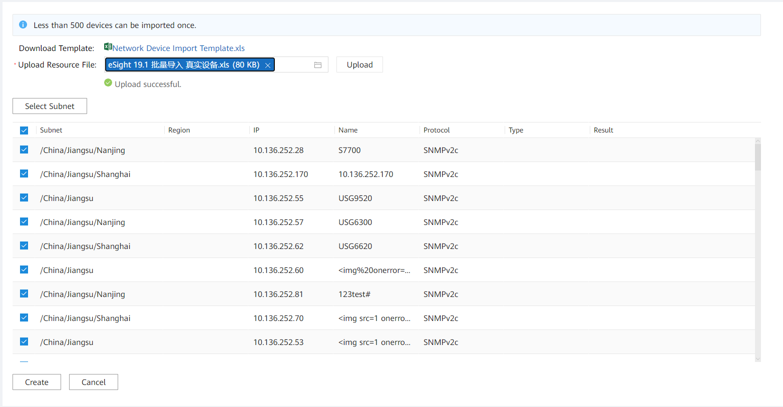
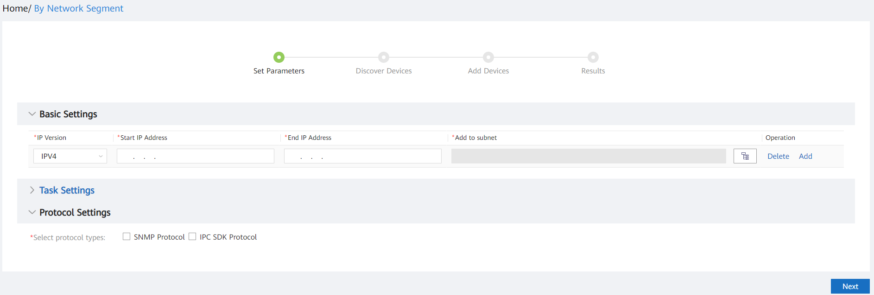
Device Addition
If SNMP parameters are correctly set for devices, you can add devices one by one, in batches, or by automatic discovery to the NMS for management.
Adding devices one by one is applicable when the number of devices is small and SNMP parameters are different for the devices.
Batch import is applicable to various scenarios.
Automatic discovery is applicable to batch addition of devices with consecutive IP addresses and the same SNMP parameter settings.

Slide 11
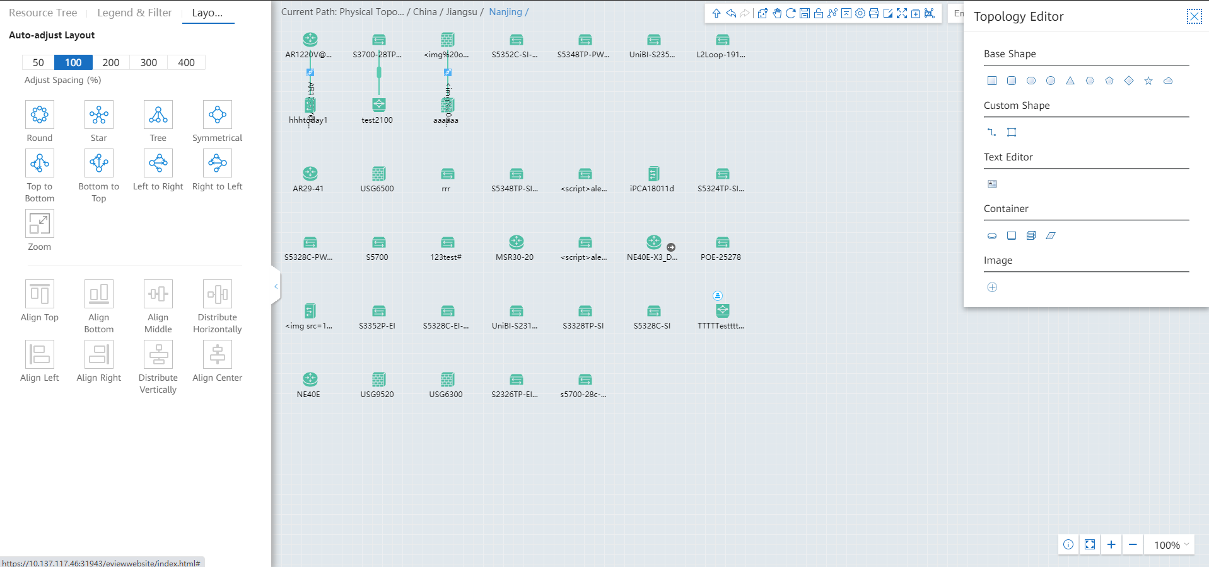
Monitoring Configuration - Topology
1. In addition to manual dragging, default common layouts of topology icons are provided for flexible configuration.
2. Figures can be expanded for improved clarity.

Slide 12
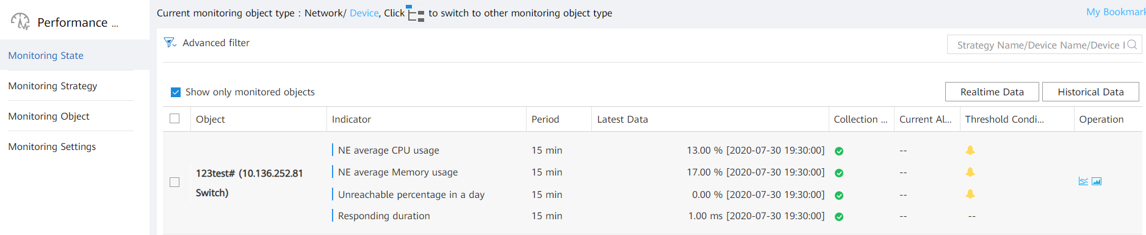
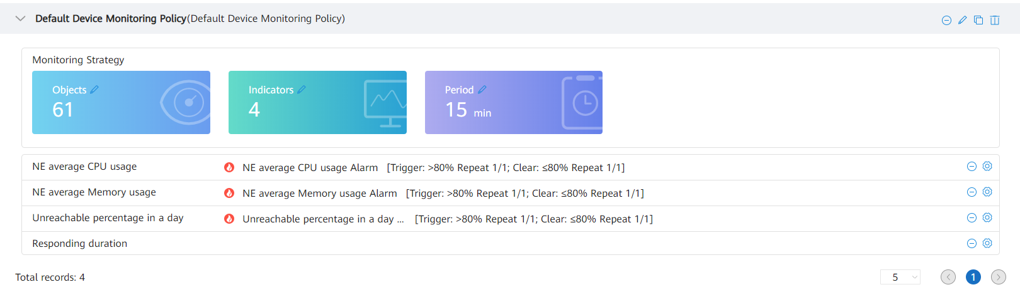
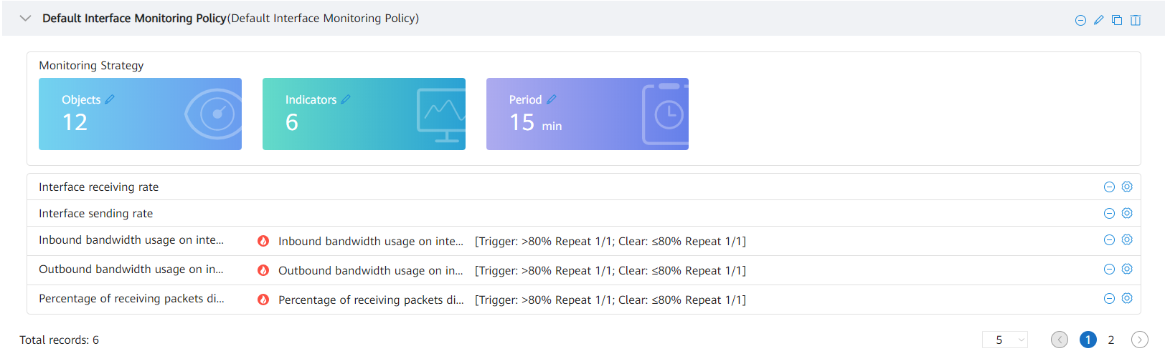
Monitoring Configuration - Performance
Creating a performance monitoring policy
Performance monitoring service
1
Monitoring object group
2
Monitoring policy
1.1 Create a monitoring object group based on certain rules.
2.1 Select monitoring indicators.
2.2 Select monitoring object groups or monitoring objects.
2.3 Select a collection period.
Preset performance monitoring policy
4
Performance data
3
Scheduled collection on the background
4.1 View latest data.
3.1 Automatic information collection
4. 2. View historical data.
4.3 View real-time performance.
Alarm management
5
An alarm is generated when the threshold is exceeded.
portal
6
View top N collected data in the homepage portal.
Presets common KPI policies are usable upon unpacking. Automatic monitoring is started after devices go online.
Various performance indicators are available. Performance monitoring policies can be extended as required.

Slide 13
Monitoring Configuration - Polling Tasks
eSight provides customized configuration parameters to improve network management efficiency and quality.
Polling/Reconciliation
Category | Scenario | Function | Default Value | Setting Notes
Between the NMS and devices | Device status polling | Check the connectivity between the NMS and devices. | The interval is 30s. | You cannot change the parameter value.
 | Polling device inventory data | Periodically synchronize all device information. | Start time: 2:20; duration: 4 hours | Full synchronization consumes system resources. Therefore, you are advised to perform full synchronization during off-peak hours, for example, in the early morning.
 | Interface status polling | Periodically check the status of link interfaces or network-wide interfaces. | No polling | It is recommended that this function be used when the alarm channel is abnormal or the alarm synchronization function is invalid. Set this parameter based on the number of devices. The larger the number of devices, the longer the polling interval.
 | Terminal data polling | Periodically obtain wired terminals and their statuses. | Every 1 hour | You cannot change the parameter value.
 | Backing up configuration files | Periodically obtain configuration files from devices. | Unstarted | You are advised to back up key devices once a day.
Operations on this page are professional. You are advised to perform these operations under the guidance of professional personnel.

Slide 14
1
Overview
2
Site Deployment
3
Routine O&M

Slide 15
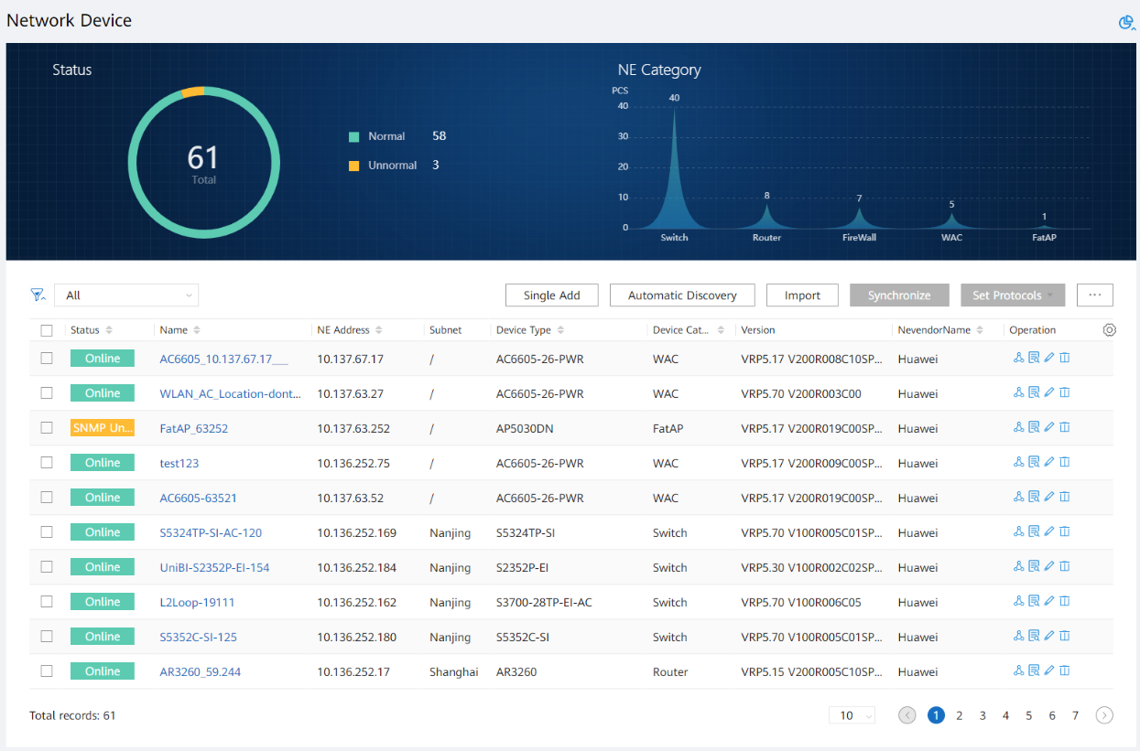
Routine O&M of Network Devices - Resource Overview
Device status statistics. You can click the rose chart to quickly filter devices.
Column customization. Many columns are available, including maintenance information.
Go to the details page of a single device and view the detailed information about the device, including alarms, KPIs, and interfaces.

Slide 16
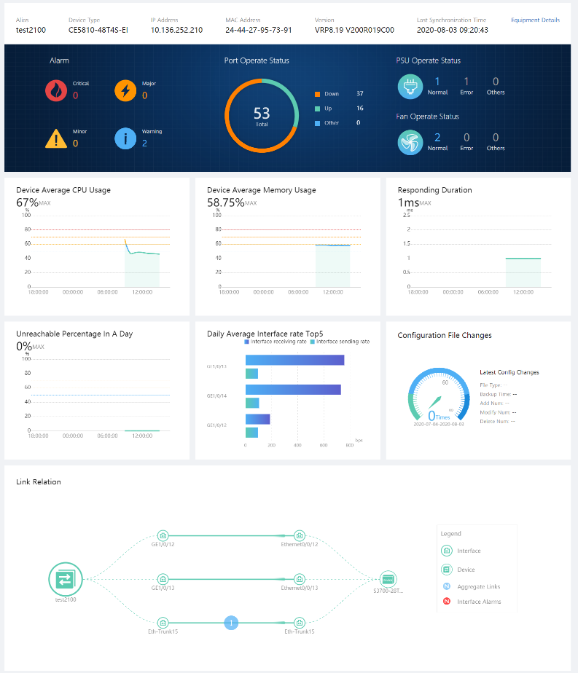
Routine O&M of Network Devices - Key Device Monitoring
Basic device information
Alarm statistics of a single device
Key resources: interface, power supply, and fan status statistics.
Device KPIs, which are marked in red if they exceed the thresholds
Connections between a single device and peripheral devices

Slide 17
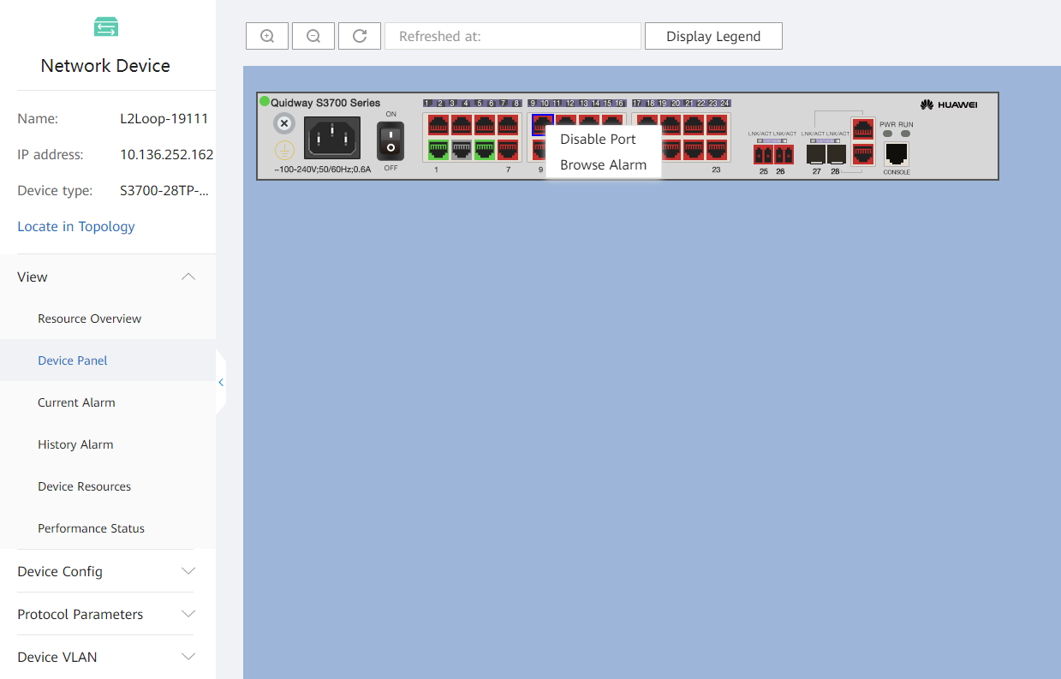
Routine O&M of Network Devices - Device Panel
The high-fidelity Huawei device panel displays devices at a ratio of 1:1. You can right-click the panel to quickly perform operations.
The low-fidelity third-party device panel displays the interface statuses.

Slide 18
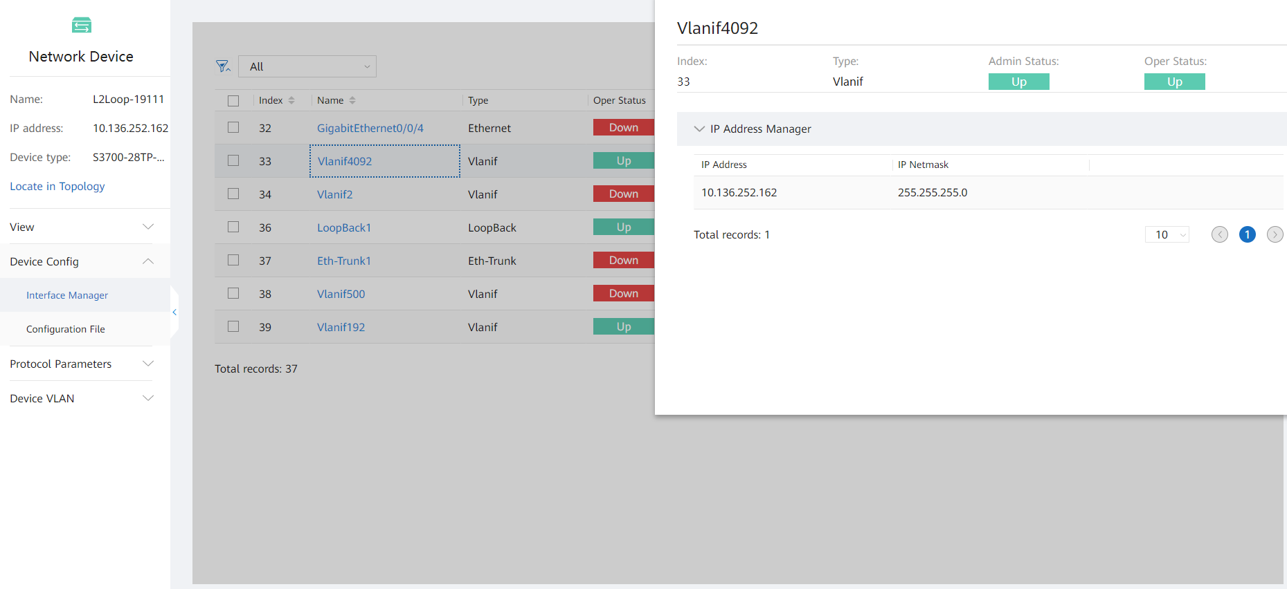
Routine O&M of Network Devices - Interface
Interface information is displayed based on matrices.
Logical sub-interfaces are not displayed.
Interface resource information is displayed, including IP addresses, Ethernet-trunk relationships, and link relationships.
Interface names and details are displayed.

Slide 19
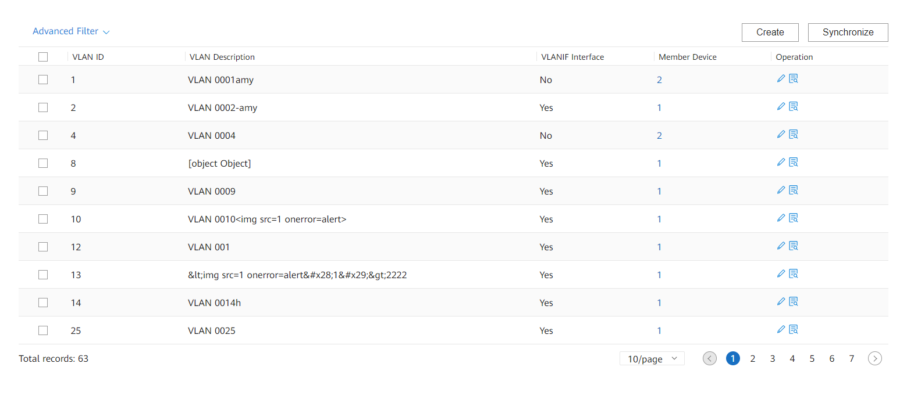
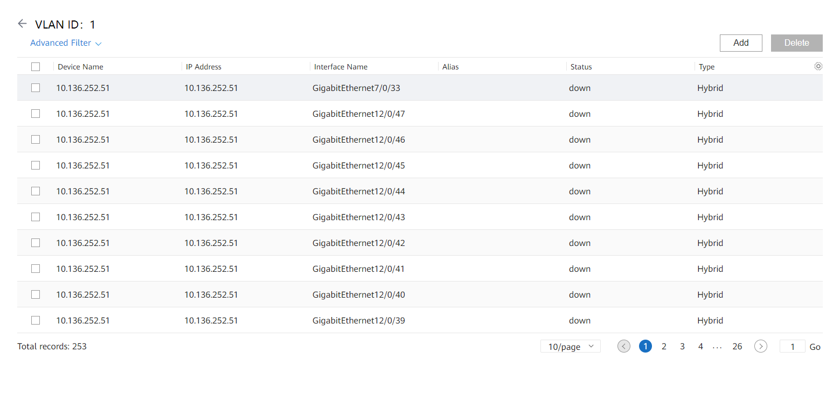
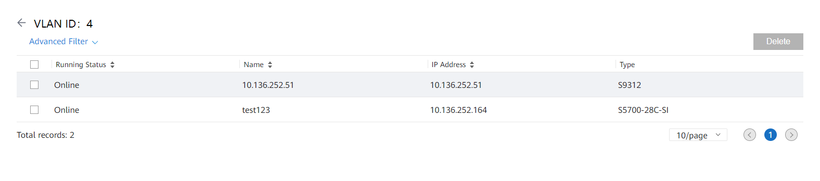
Routine O&M of Network Devices - VLAN
View, add, and delete interfaces that can connect to the VLAN.
View and remove VLAN member devices.

Slide 20
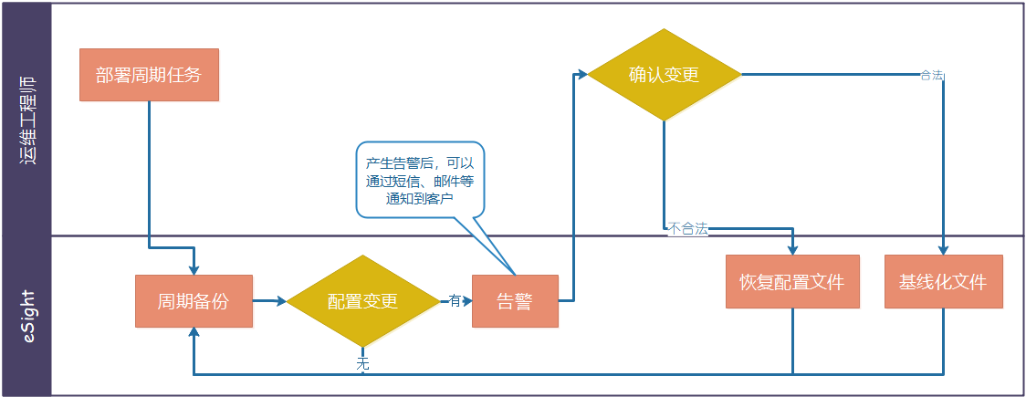
Routine O&M of Network Devices - Configuration File Management
O&M principle: To ensure network stability, minimize device configuration changes. When device configurations on a network change, O&M engineers must be aware of the change, check whether the change is valid, and take measures in a timely manner to prevent the network from being attacked or modified illegally.
Deployment of periodic tasks
Is the change valid?
Valid
O&M engineers
Alarm notifications can be sent to customers via SMS messages or emails.
Invalid
Is the configuration changed?
Configuration file restoration
Baselined files
Periodic backup
Yes
Alarm
No

Slide 21
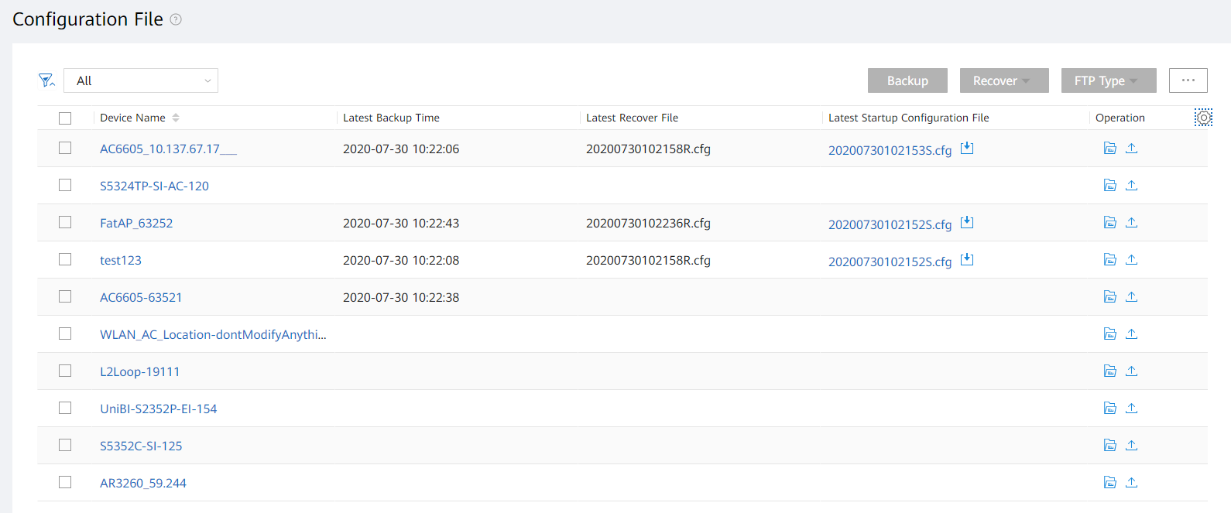
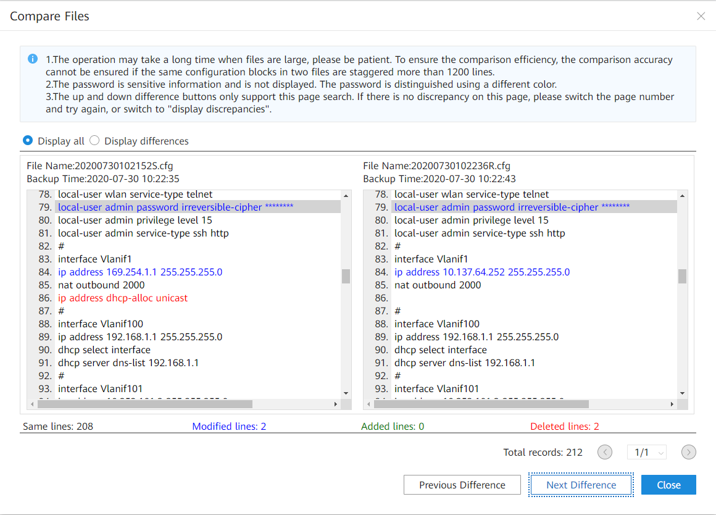
Routine O&M of Network Devices - Configuration File Management
Users can quickly view the latest configuration files and download them to the local computer for archiving.
Check the detailed backup file list on the device.
The differences in the configuration file are marked in red. You can quickly check whether the changed content is valid.
Traverse the differences one by one to avoid repetition or omission.

Slide 22
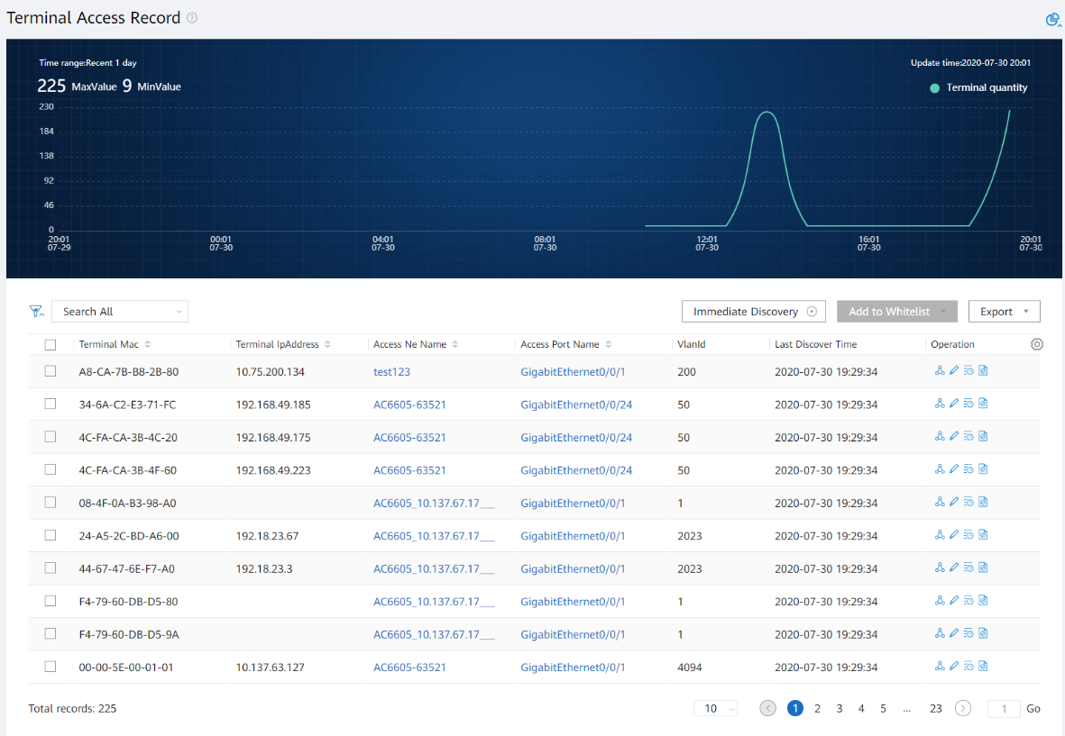
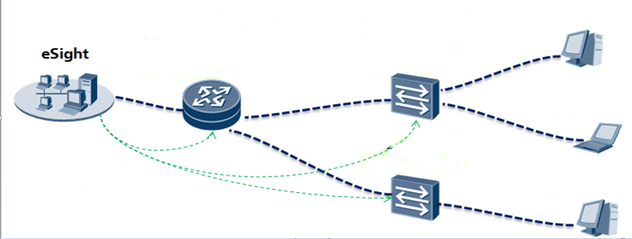



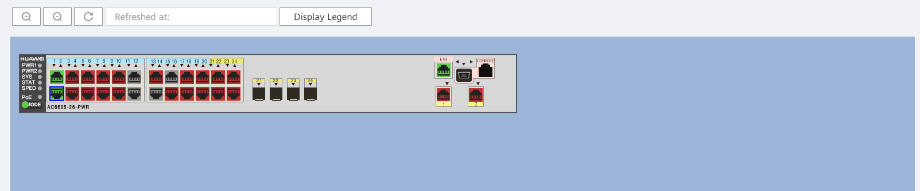
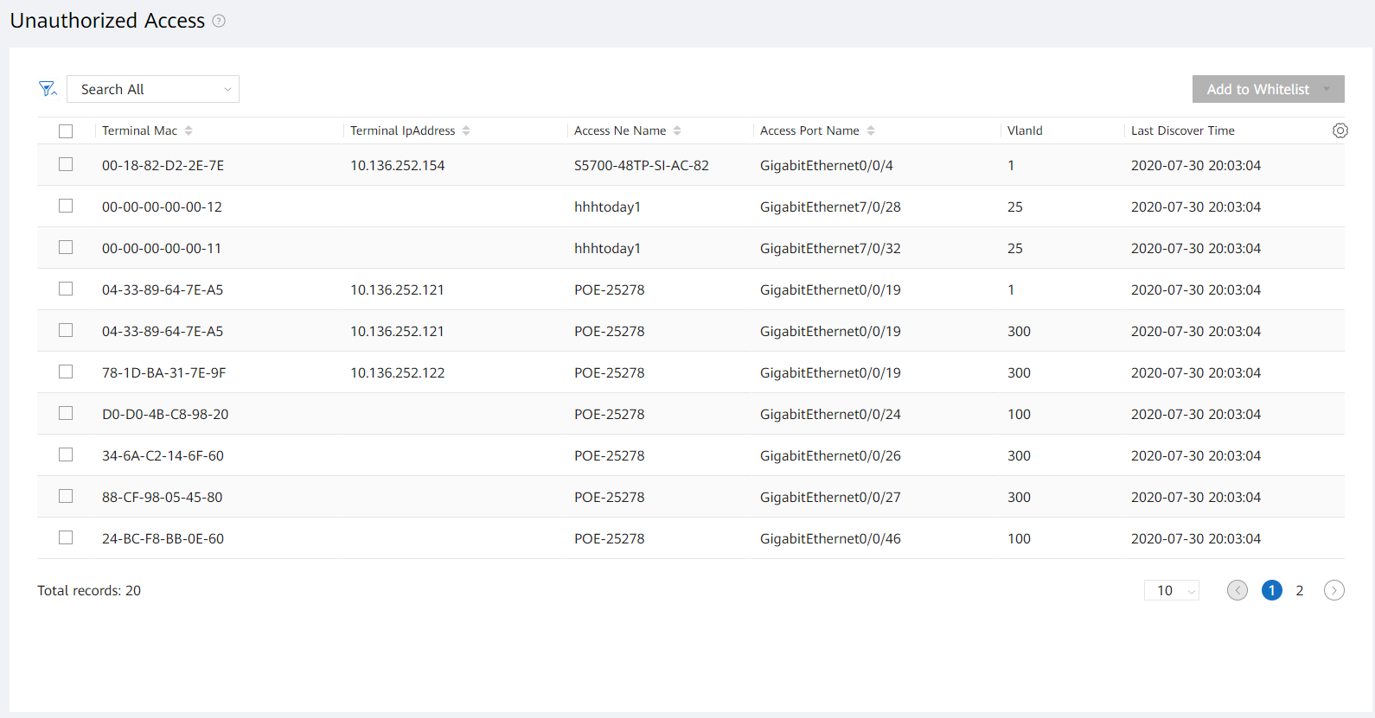
Routine O&M of Network Devices - Terminal Monitoring
Terminal discovery principles
Router-ARP table
port1 | ip1 | mac1
port2 | ip2 | mac2
port3 | ip3 | mac3
SW1-MAC forwarding table
mac1 | port1
mac2 | port2
Terminal A (mac1, ip1)
Terminal B (mac2, ip2)
View the recovery suggestions.
SW2-MAC forwarding table
mac3 | port3
Collects device MAC forwarding table and ARP table data
Terminal C (mac3, ip3)
1
Associate with the NE manager and device panel to quickly view the running status, performance indicators, and alarms of devices and ports and rectify terminal network faults.
2
Create a terminal access whitelist and bind terminal access rules
to generate alarms for unauthorized terminals.

Slide 23
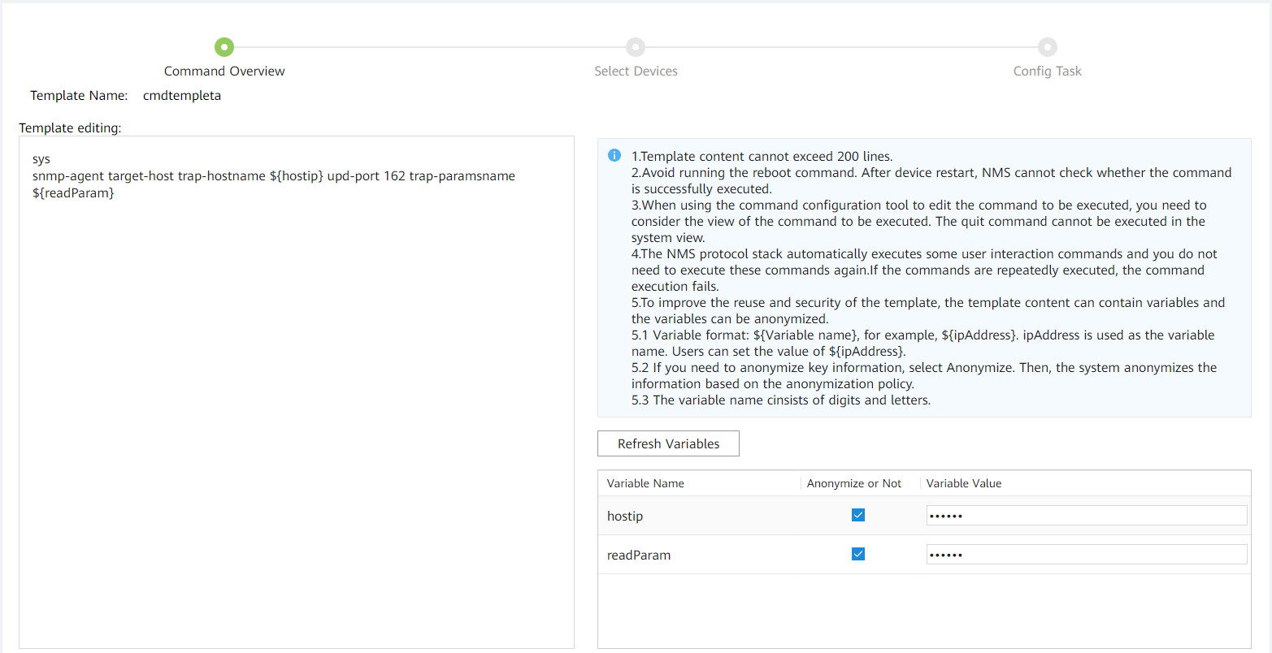
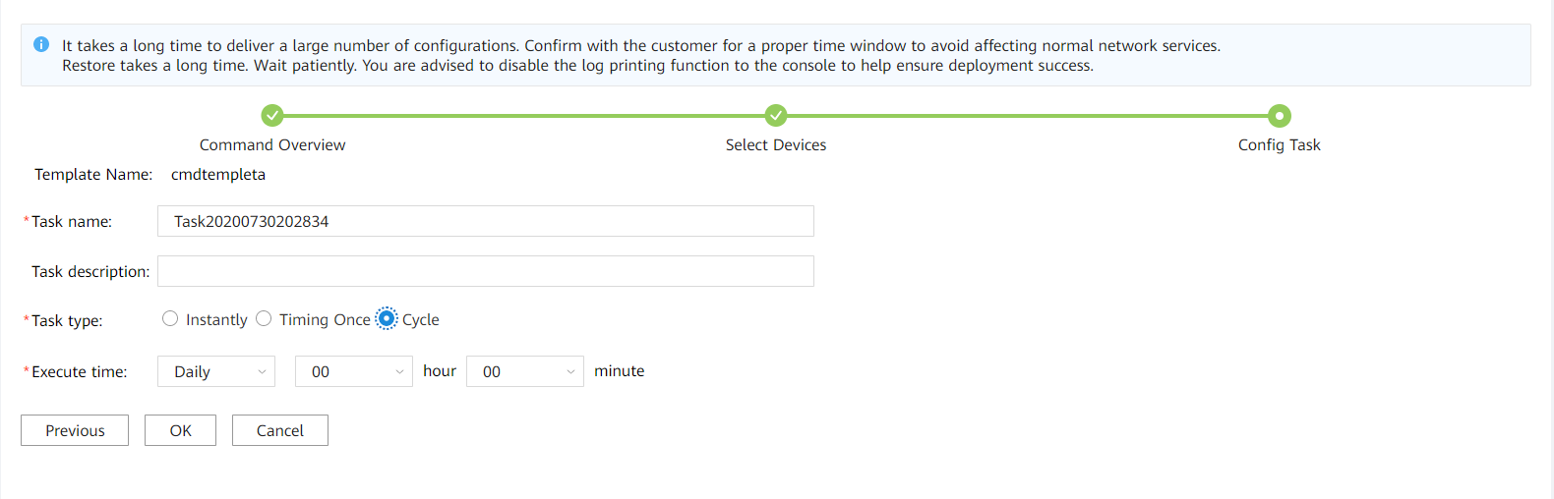
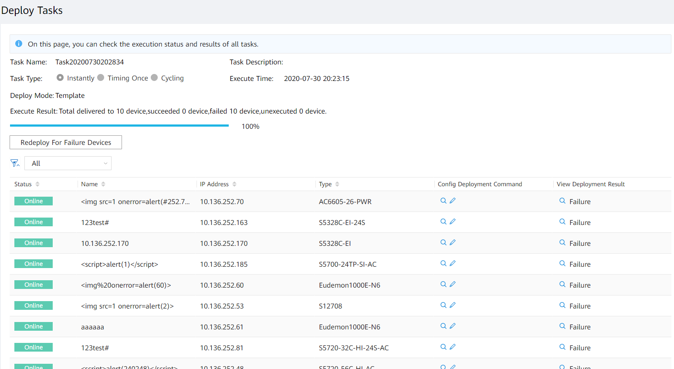
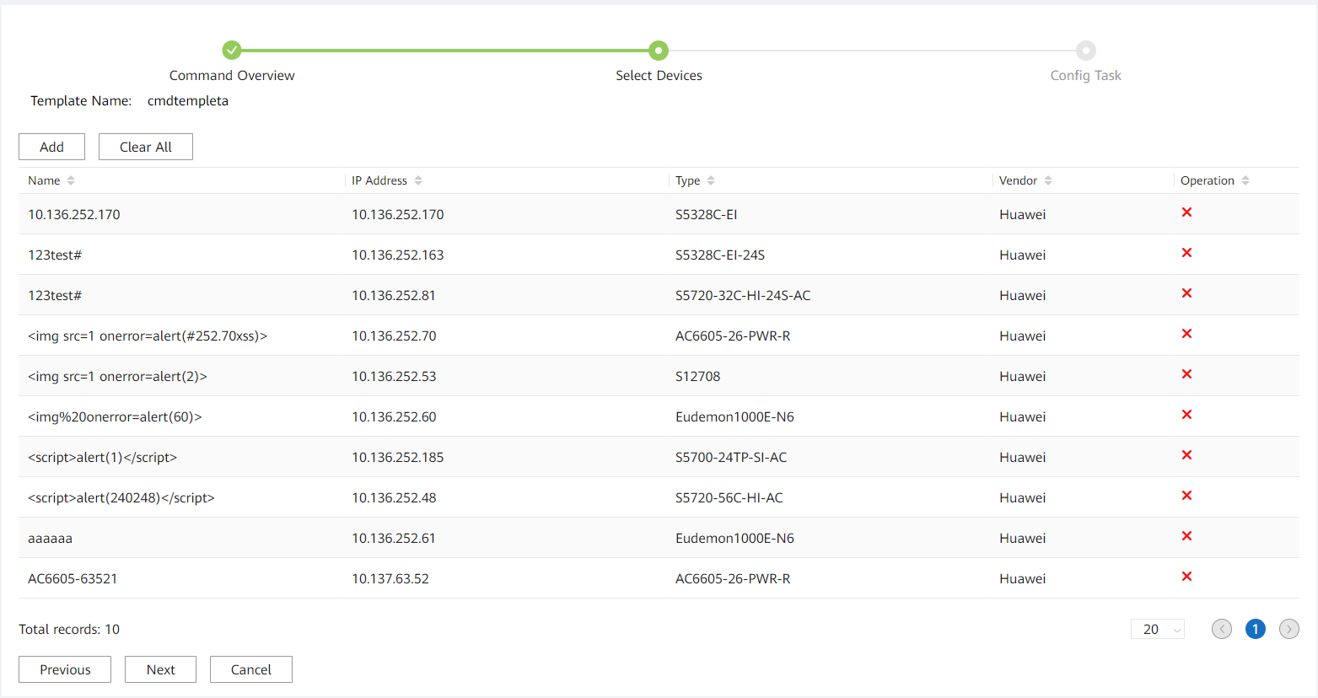
Routine O&M of Network Devices - Command Configuration Tool
O&M method: Configuration operations on a large number of NEs are mandatory during network construction or reconstruction. Manually making scripts according to the network plan is time-consuming and error-prone. The command configuration tool of eSight allows users to use a configuration template and a plan sheet to deliver parameters in a batch to NEs by one click, improving NE configuration efficiency.
Create a template.
Select devices.
Configure an execution policy
View the task execution result
23Page

